Slide 1
Feature Selection Method Based on Grey
Wolf Optimization for Coronary Artery
Disease Classification
MIT2018050 Rishu Raj
MIT2018061 shubham Patre
MIT2018072 Kaushal Sahu

Slide 2
Content
What is Grey wolf optimizer(GWO)
Social hierarchy of GWO
Grey wolf encircling prey
Grey wolf hunting
Attacking prey (exploitation)
Search for prey (exploration)
GWO algorithm
Proposed method
Result

Slide 3
What is Grey wolf optimizer(GWO)
Grey wolf optimizer (GWO) is a recently proposed swarm intelligence optimization method inspired by hunting behavior of grey wolves.
It is a population based metaheuristics algorithm that simulates the leadership hierarchy and hunting mechanism of gray wolves in nature proposed by Mirjalili in 2014.
Grey wolves prefer to live in a groups (packs), each group contains 5-12 members on average

Slide 4
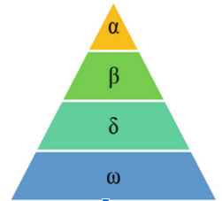
Social hierarchy of GWO
The social hierarchy consists of four levels as follow.
The first level is called Alpha (𝛼). The alpha wolves are the leaders of the pack.
The second level is Beta, which acts as a substitute for alpha wolves.
The third level is Delta, which consists of scouts, hunters caretakers etc.
The last one is Omega, which is weakest of all and follow other wolves.

Slide 5




Grey wolf encircling prey
During the hunting, the grey wolves encircle prey.
The mathematical model of the encircling behavior is presented in the following equations.
The vectors A and C are calculated as follows
t is current iteration
A and C are coefficient vectors
Xp is the position vector of the prey
X indicates the position vector of a grey wolf.

Slide 6
Grey wolf Hunting
The hunting operation is usually guided by the alpha. The beta and delta might participate in hunting occasionally.
In the mathematical model of hunting behavior of grey wolves, we assumed the alpha , beta and delta have better knowledge about the potential location of prey.
The first three best solutions are saved and the other agent are obliged to update their positions according to the position of the best search agents as shown in the following equations.

Slide 7
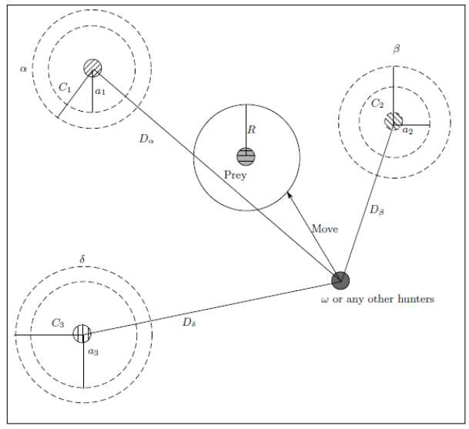
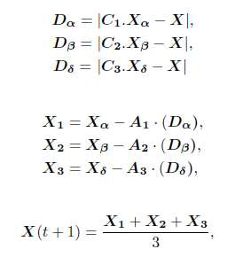
.
.

Slide 8
Search for prey (exploration)
The exploration process in GWO is applied according to the position , and , that diverge from each other to search for prey and converge to attack prey.
The exploration process modeled mathematically by utilizing A with random values greater than 1 or less than -1 to oblige the search agent to diverge from the prey.
When |A| > 1, the wolves are forced to diverge from the prey to find a fitter prey.

Slide 9
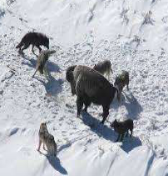
Attacking prey (exploitation)
The grey wolf finish the hunt by attacking the prey when it stop moving.
The vector A is a random value in interval [-2a, 2a], where a is decreased from 2 to 0 over the course of iterations.
When |A| < 1, the wolves attack towards the prey, which represents an exploitation process.

Slide 10
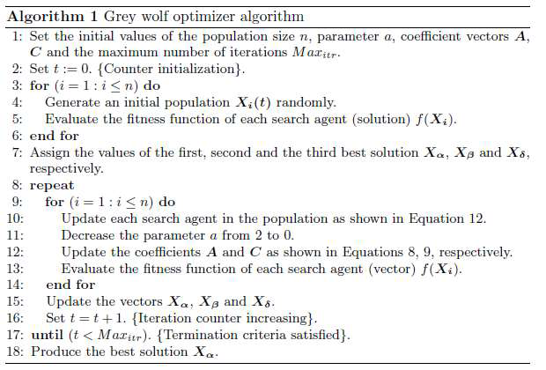
Algorithm

Slide 11
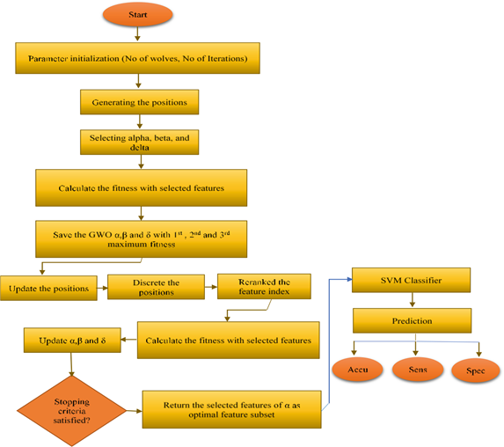
Proposed Method
.

Slide 12
Proposed Method:
Wrapper feature selection based on GWO and SVM
GWO-SVM has been used for the diagnosis of heart diseases based on 13 features of patient
It has two phases:
Eliminate redundant and irrelevant features
SVM is applied on the selected features by GWO
Accuracy increases in case of GWO-SVM compared to SVM

Slide 13
Results
A comparison was conducted between the proposed method and other competitive counterparts feature selection methods.
Experimented results demonstrated that the proposed method performed greatly in terms of accuracy and outperformed the state-of-art methods.
GWO-SVM: 61.4%
SVM : 59.8%

Slide 14
Future changes:
Different classifiers could be used with GWO to further enhance the results.
Moreover, some other datasets can be applied in the future to further investigating the robustness of the proposed method.

Slide 15
References
S. Mirjalili, S. M. Mirjalili, and A. Lewis, "Grey Wolf Optimizer," Advances in Engineering Software, vol. 69, pp. 46-61, 2014.
Yan Wei, Ni Ni, Dayou Liu, et al., “An Improved Grey Wolf Optimization Strategy Enhanced SVM and Its Application in Predicting the Second Major,” Mathematical Problems in Engineering, vol. 2017, Article ID 9316713, 12 pages, 2017.
Al-Tashi, Qasem & Rais, Helmi & Jadid Abdulkadir, Said. (2018). “Feature Selection Method Based on Grey Wolf Optimization for Coronary Artery Disease Classification.” 257-266. 10.1007/978-3-319-99007-1_25.

